Slide 1
Suzanne & Richard Pieper Family Foundation
Servant-Leader Chair
Annual Presentation 2020

Slide 2
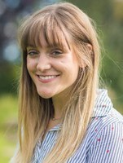
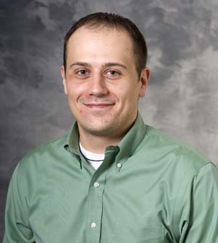
Acknowledgments
Paige LaPoint
Director, Student Organizations and Leadership Development
College of Engineering
Mark Kueppers
Assistant Dean: Wisconsin Union
Director: Center for Leadership and Involvement (CfLI)
Barb Kautz-Wittwer
Assistant Director of Leadership Development at CfLI
Co-Coordinator of Leadership@UW
James Yonker
Administrative Program Specialist, Division of Diversity, Equity, and Educational Achievement, Provost’s Office
Numerous campus partners

Slide 3
Outcomes Measures (Criteria 1, 3, and 4)
Senior Exit Survey
Student Satisfaction with Leadership Opportunities in Engineering Program Extracurricular Activities
Multi-Institutional Study of Leadership
Average Scores on Socially-Responsible Leadership Scales
Overall Scale
Citizenship Scale

Slide 4
Carrying Out Mission of Chair (Criteria 2, 6)
Campus-wide coordinated leadership initiative
Chancellor’s Scholar Program
Alignment with College of Engineering Student Leadership Center and CfLI
Funding projects by student orgs (service-learning or community outreach projects that “lift up society, enrich organizations and communities, and have a positive effect on the least privileged”)
Volunteering for student orgs
Building Community-Based Learning into Senior Design, Freshman Design
Volunteering for Madison Water Utility’s Water Quality Advisory Group

Slide 5
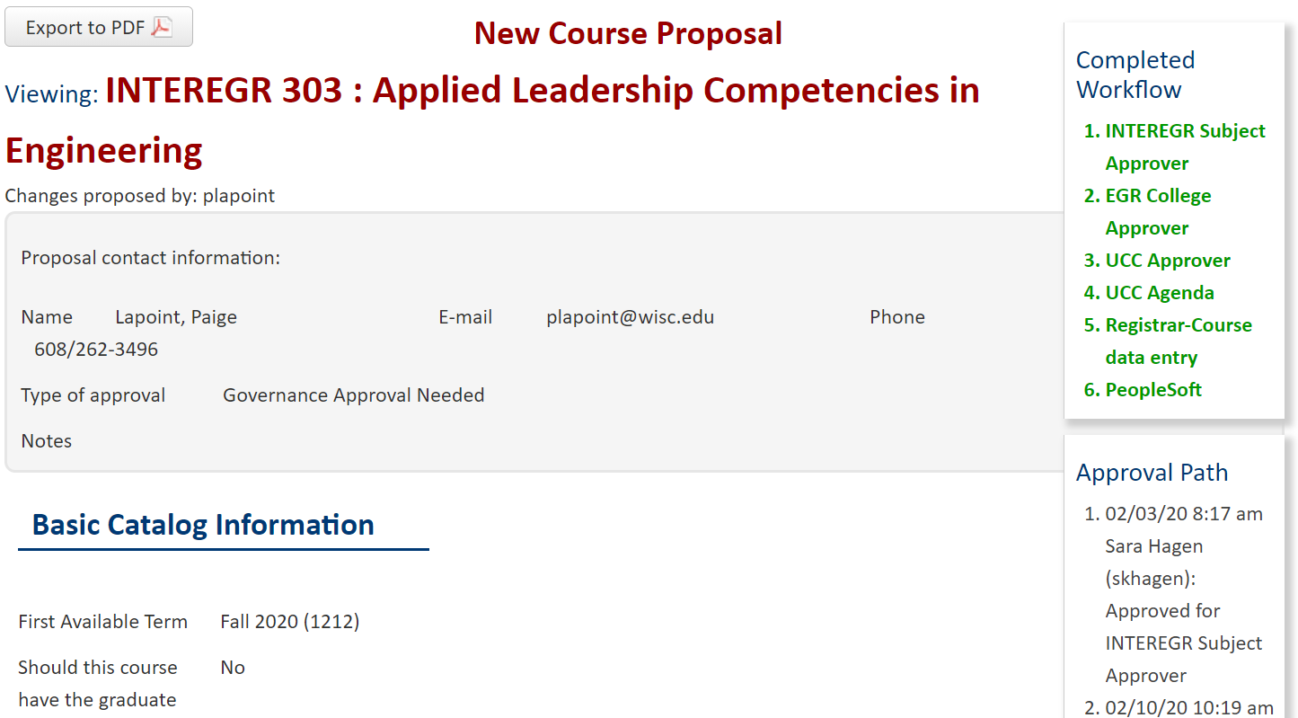
Breakthrough Ventures (Criterion 5)
Paige LaPoint, COE Director of Student Organizations and Leadership Development
Developed the “Emerging Leaders in Engineering” Program
Promotes student involvement in engineering through professional development opportunities, personal exploration, and civic engagement
Created class and got it approved by COE and Campus
Students continue on to earn the UW-Madison Leadership Certificate
Mentor network for program and for student orgs

Slide 6
Breakthrough Ventures (Criterion 5)
Example Results from Multi-Institutional Survey of Leadership

Slide 7
Breakthrough Ventures (Criterion 5)
MSL OUTREACH BEYOND COE
Task Force Report
Campus
Big Ten
MSL Team
Webinar
60-70 attendees from above groups
Publicity

Slide 8
Breakthrough Ventures (Criterion 5)
MSL OUTREACH BEYOND COE
Task Force Report
Campus
Big Ten
MSL Team
Webinar
60-70 attendees from above groups
Publicity

Slide 9
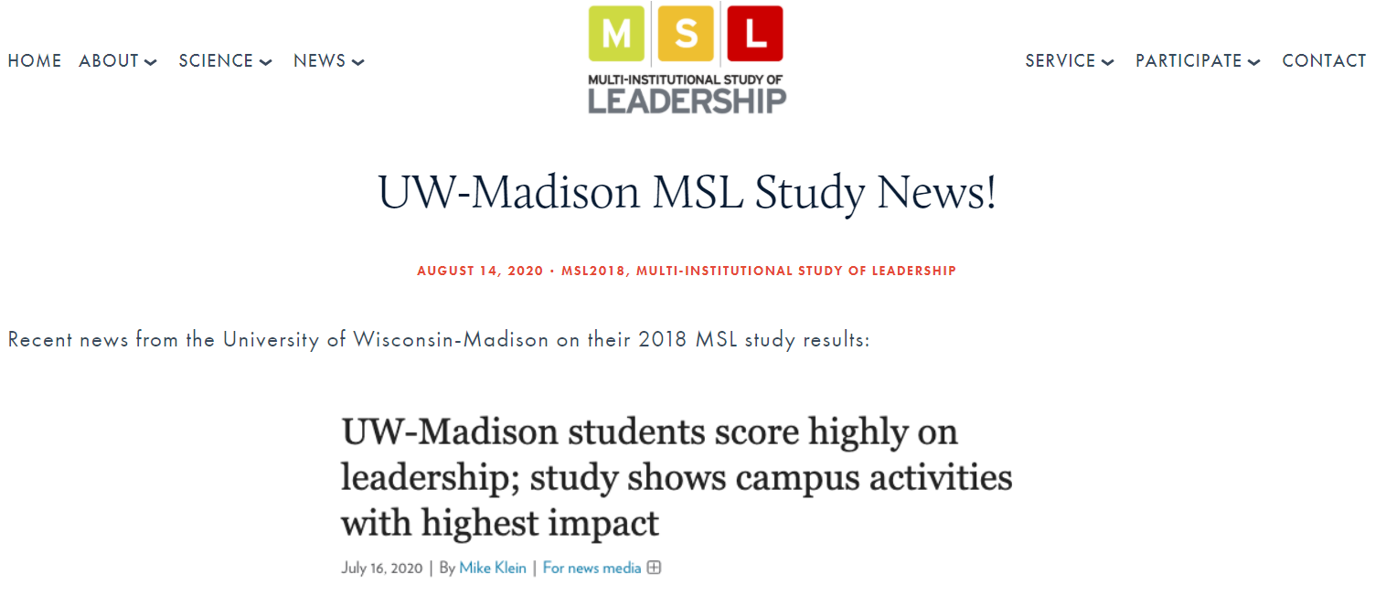
Breakthrough Ventures (Criterion 5)
MSL OUTREACH BEYOND COE
Task Force Report
Campus
Big Ten
MSL Team
Webinar
60-70 attendees from above groups
Publicity

Slide 10
Example of a Servant Leader (Criterion 7)
We do have many students within the college and campus-wide who serve in positive ways; examples are:
College-level: Largest student chapter of Engineers Without Borders in U.S.
Campus-level: 2nd largest number of Peace Corps volunteers in U.S.
Prior to this year, we have lacked infrastructure to follow our student leaders and the work they do
Paige has developed the infrastructure and serves as a point person who can rigorously consider students and alumni for this criterion (used to pair alumni mentors with students in class/program)
We expect to have a nominee next year

Slide 11
Goals for 2020-2021
Lead UW-Madison in 2021 edition of the Multi-Institutional Study of Leadership
Last time: surveyed 1/3 of undergrads; this time: survey all undergrads
Continue multi-unit collaboration across campus
Continue working with Big Ten institutions (UW scheduled to host next Big Ten summit)
Data available in late July 2021 – analysis from then until 2023
COE Leadership Development work
Offer InterEgr 303 course for first time (already underway)
Continue leading students through emerging leaders program
Continue developing alumni network for mentorship
Center for Education Innovation
Work with Deans Office to integrate Pieper Chair into this center

Slide 12
Thanks for listening and thanks to the
Suzanne & Richard Pieper Family Foundation for their continued support

