Slide 1
Pieper Family Foundation Annual Presentation
November 4, 2020

Slide 2
Quick summary of Ripon College over the last six months
Went to Online Education over spring break
Came back in August (early) with students on campus, classes either online, hybrid, or face-to-face (distanced)
So far, infection rates are low, but not county-wide
Larger first year class than anticipated
But smaller class last year led to loss of some younger faculty

Slide 3
Background: What is Servant Leadership?
Greenleaf: The Servant Leader is servant first
Then conscious choice brings one to aspire to lead
Greenleaf: One can identify Servant Leadership by the effects on those being led. “Do they, while being served, become healthier, wiser,…more likely themselves to become servants?”
And, “what is the effect on the least privileged in society: will they benefit, or, at least, will they not be further deprived?”

Slide 4
Is Ripon College an effective Servant Leader?
Emphasis is on the growth of the student
Effects on the least privileged in society
Ripon College is enrolling an increasing percentage of first-generation and disadvantaged-background students
Their graduation rate remains above the averages for similar colleges.

Slide 5
Outcome 3: Student outcomes
Question | Ripon College | Comparison 1 | Comparison 2
Participating in a community action program (essential or very important) | 27% (the office coordinating this lost its funding two years ago) | 41% | 42%
Performed volunteer or community service work (frequently) | 16% | 18% | 18%
Performed community service as part of a class (frequently or occasionally) | 76% | 73% | 74%
Becoming a community leader (very important or important) | 41% | 47% | 45%

Slide 6
Outcome #4: Phenomenally above norms?
I would not make this claim based on our data from this year.

Slide 7
Outcome 5: Breakthrough ventures that promise new beginnings
Failure is part of the Servant Leader experience
The Ripon-Jamaica program was shelved due to financial concerns on the part of the College
Funds were transferred to the Blue Mountain Project in Jamaica for use in educating rural students
Planned partnership between selected Jamaican students and Ripon students were not possible
2020 Jamaica Service Learning trip canceled

Slide 8
Outcome 5, continued
2. The initiation of the Ripon College/Fox Lake Correctional Institution program
This occurred during the fall of 2019
Was put on hold in February due to COVID concerns
Has not resumed at this point

Slide 9
Outcome 5, continued
3. Proposed Positive Leadership Program was not approved
Remains “of interest” to faculty and administration
“Trying to decide whether to add a porch during a hurricane”
Possibilities of new staff hirings may impact this

Slide 10
Other COVID cancellations
Student internships to Green Lake County Jail
Student internships at high school for at-risk students
Student internships at nursing homes

Slide 11
Outcome 6: Carrying out the Chair’s mission
I’ve continued my previous activities
I have continued to add Servant Leadership to all of my classes, spending at least one class period on this topic
And including other elements consistent with the aims of Servant Leadership
Service, the value of improving the lives of the disadvantaged

Slide 12
1. Facilitate and nurture student leaders formally and informally
Offered two classes on Servant Leadership
A “Master Class” to first year students before their arrival
12 first year students read the “orange” Greenleaf and Keith
Servant Leadership (half semester/2 credits)
27 students (three from the “Master Class”
Focused on the “stories” of Servant Leadership
Speakers, local and Reginald Lewis, Executive Director of the Greenleaf Center

Slide 13
2. Work in my professional discipline
Taught three courses on Counseling/Psychological Disorders
Taught the Listening Skills so important to Servant Leadership
Helped those who want to work in “service professions”
Advising and mentoring
Added Servant Leadership lectures to General Psychology
Provided professional mental health services in nursing homes
Especially important during the pandemic
Would typically take students in with me, but not now

Slide 14
3. Creation of scholarly papers and articles
Areas of thought
1. What are the developmental stages to Servant Leadership?
Stories of Servant Leaders are highly varied
Childhood, Inspirational parents, inspirational moments
2. Pros and Cons of the Faith-based associations in Servant Leadership
Can open doors, especially in business, that may otherwise remain closed
Can lead to uneasiness for more secular audiences

Slide 15
4. Work to add Servant Leadership principles to the curriculum
Teach courses (as I’m already doing)
90 students this semester were exposed to the ideas of Servant Leadership through my classes
Add Servant Leadership to the Catalyst Curriculum
Have been appointed to the Planning Committee for that curriculum
First act was to recommend that we add this element to the Curriculum, probably in the third year

Slide 16
4. Continued // Staffing
It is clear that the Chair needs to network with other interested faculty members
Dr. Jennifer Stalnaker, Assistant Professor of Economics/Business Mangagment, background in leadership
Unfortunately, left the College in the late spring
Ms. Sahnya Thom, Ph.D. candidate in Industrial/Organizational Psychology, specialty in Leadership
Proposed head of Positive Leadership program
Was hired as a one-year Visiting Professor of Psychology
Ms. Maria Mendoza-Bautista, Director of Multicultural Affairs
Masters in Servant Leadership

Slide 17
Outcome 7: Outstanding potential Servant Leaders
Addition of new language opening up this category to potential leaders is a welcome change

Slide 18
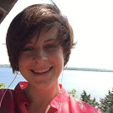
Haley Madson
Went to Jamaica as part of 2009 trip
Subsequently went five more times, joined the Board, served as admin
Locally, has always worked in public service with:
Diverse Options, employment of the handicapped
Oshkosh Area Community Pantry
Co-founded Re:Claimed Foster Closet, which outfits foster families
Parent Support Program Supervisor at Professional Services Group

Slide 19
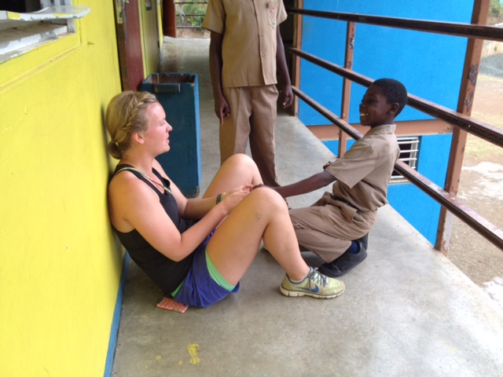
Sydney Radandt
Went to Jamaica in 2014, returned three more times before graduation
AmeriCorps after graduation
Peace Corps in Namibia
Natural leader among students and colleagues

